Slide 1
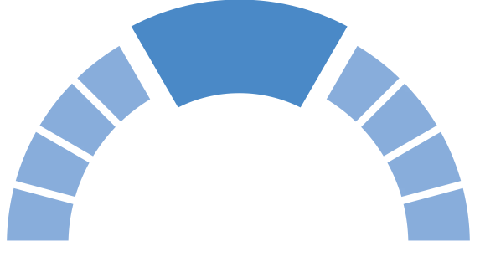
Gifted Education Section, CDI, EDB Learning and Teaching Resources for Scientifically Gifted/ More Able Students
Food Chains &
Keystone species
(S1 Science – Unit 3: Looking at Living Things
S2 Science – Unit 7: Living things and air)
September 2021

Slide 2
Prior knowledge
Students should have developed a basic understanding of the following:
a food chain as a representation to show the feeding relationship between organisms;
the interdependence between living things and environment

Slide 3
Learning objectives
Knowledge:
to understand the meaning of ‘keystone species’
to understand the inter-relationship between organisms in a community
Skill:
to analyse and interpret secondary data
Attitude:
to respect and care for living things and show concern for endangered species and keystone species

Slide 4
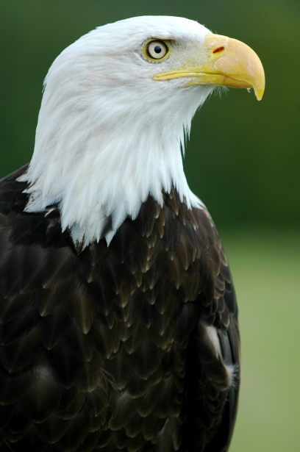
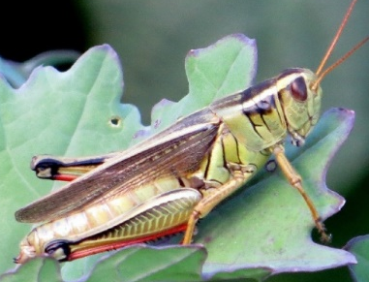
Consider the food chain below:
lettuce
grasshopper
lizard
eagle

Slide 5
Activity: Traffic Light
To see if students feel they can apply a concept/idea.
The teacher presents a statement/ question and the students respond by placing either a red, yellow, or green card.
Teacher and students can immediately check the overall students’ responses and teacher can invite students to share their views.
Agree
Disagree
Not sure
Notes:
Tips of implementation:
This activity can help elicit students’ thinking about the concept of food chain that they should have learnt in primary school and facilitate class discussion.
The use of red, yellow and green cards can give a visual support which allow both teachers and students to understand what others’ thinking. This can facilitate students’ further elaboration or explanation.
Other than using red, yellow and green cards, teachers are advised to ask students to show “thumb up/ thumb middle/ thumb down” to indicate their understanding.
Teachers can also use electronic tools to visualise students’ thinking.

Slide 6
Statements
Lettuce is at the start of the food chain.
Lettuce is the producer.
Lettuce is the consumer.
Grasshopper is the producer.
Grasshopper is the consumer.
Lizard eats eagle.
Eagle eats lizard.
Eagle eats grasshopper and lizard.
Grasshopper cannot eat lettuce because grasshopper is smaller than lettuce.
There is one eagle in the food chain.
Notes:
Tips of implementation
Depends on students’ readiness, teacher can select some statements to probe students’ understanding.
Statement 1-7 focus on basic understanding of terminologies (e.g. producer and consumer) and direction of arrow presented in a food chain.
Statement 8-10 focus on abstract understanding of food chain (which may challenge the understanding of gifted/ more able students:
For students who agree with the statement 8 may believe that organisms at a higher level in the food chain can consume all the organisms below.
For students who agree with the statement 9 may believe that the feeding relationship depends on the size of the organisms.
For students who agree with the statement 10 may believe that species indicated in a food chain refer to a single organism instead of a population of an organism
Suggested answer:
True
True
False
False
True
False
True
False
False
False

Slide 7
Statement 8
lettuce
grasshopper
lizard
eagle
Eagle eats grasshopper and lizard.
Agree
Disagree
Not sure

Slide 8
Statement 10
lettuce
grasshopper
lizard
eagle
There is one eagle in the food chain.
Agree
Disagree
Not sure

Slide 9
Brainstorming
If a top predator goes extinct, could this cause a particular plant go extinct as well? If so, how?
Notes:
Tips of implementation:
It is an open-ended question that cannot be answered simply a “yes” or “no”.
It helps promote gifted/ more able students’ creativity and higher-order thinking skills.
Possible answers:
Yes – If a top predator goes extinct, the number of herbivores increase which may consume all the plants.
No – If a top predator goes extinct, the number of herbivores may not increase drastically as they compete for the same food and hence the growth rate of the plants still much outweigh the growth rate of herbivores. Therefore, the plants would not go extinct.
(Accept other reasonable justification)
For extension to the gifted/ more able students
The teacher may discuss limitation that cannot be presented by the food chain:
Some organism can consume more than one kind of organism.
The growth rate or food consumption rate of organisms may not be equal to one another.

Slide 10
Popular idea about ecology before 1960s
The number of producers limits the number of herbivores.
In turn the number of herbivores limits the number of predators that feed on them.
Every level was regulated by the amount of food.
Predator
Herbivore (plant-eating animals)
Bottom-up view
Producer
Notes:
It offers some historical enrichment for gifted/ more able students to understand the tentative nature of scientific knowledge

Slide 11
Green World Hypothesis proposed in 1960s
The number of herbivores is controlled not only from the bottom up, but also from the top down.
Predators are the key to keeping our world green because they keep the numbers of plant-eating herbivores from growing out of control and consume all plants.
Predator
Herbivore (plant-eating animals)
Bottom-up view
Top-down view
Producer
Hairston, N. G., Smith, F. E., & Slobodkin, L. B. (1960). Community structure, population control, and competition. The american naturalist, 94(879), 421-425.

Slide 12
Ecological experiments by Prof. Robert Paine (1960s)
Prof. Paine conducted a series of experiments to study the role of predators. He identified organisms present in a rocky shore and then he mapped out the feeding relationship between the organisms and constructed a food web.
Starfish
海星
Sea Snail
海螺
Sea Urchin
海膽
Barnacle
藤壺
Chiton
石鱉
Mussel
青口
Limpet
帽貝
Algae
海藻
The food web shown here is simplified.

Slide 13
Experiment 1
Prof. Paine removed the starfish from the food web over a two year study and he obtained the result below.
What do you see about the result?
What do you wonder about the role of the starfish in the food web?
What other experiment would you suggest for Prof. Paine to verify his hypothesis?
15
Number of species
8
Before
removal
After
removal
Notes:
Suggested answers:
After removal of the starfish, the number of species decrease from 15 to 8 after 2 years.
The starfish can maintain the number of species in the community.
Prof. Paine may repeat his experiments to ensure the reliability.

Slide 14
Experiment 2
Prof. Robert Paine repeated his earlier experiments by removing the starfish in another region. The number of species decreases from 20 to 14.
What does the result show?
Moreover, instead of removing the starfish, he removed other species. The result indicated that the number of species remain unchanged.
What does the result show?
Notes:
Suggested answer
2. Starfish can maintain the number of species
3. Some organisms (e.g. starfish) can have greater impact to other organisms.

Slide 15
Summary
Based on findings, he coined the term ‘keystone species’ to illustrate that some species can have a disproportionately large effect on its natural environment.
The theory of keystone species is influential to different areas in ecological sustainability (e.g. population management)

Slide 16
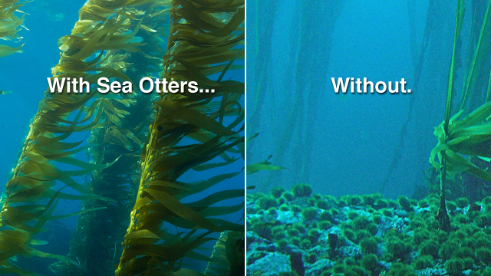
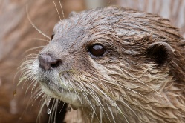
Extended research about keystone species
In 19th century, sea otters were hunted for fur trade. It is now an endangered species.
Sea otters is also a keystone species in marine region. Let’s do some online research about sea otter on how they work as a keystone species.
The photo is extracted from :
https://www.seaotters.com/2013/05/why-are-sea-otters-important-no-sea-otters-no-kelp-forests/

Slide 17
Reference
Allen, M. (2014). Misconceptions in Primary Science, 2nd edn, UK: Open University Press.
Hairston, N. G., Smith, F. E., & Slobodkin, L. B. (1960). Community structure, population control, and competition. The American Naturalist, 94(879), 421-425.
Paine, R. T. (1966). Food web complexity and species diversity. The American Naturalist, 100(910), 65-75.

